Slide 1

VisionXplorer
Smart Glasses, made for the future

Slide 2
About VisionXplorer
Our cutting-edge product is a pair of smart glasses designed to revolutionize how we perceive and interact with the world. Featuring live text translation, monitoring and navigation functionalities, these glasses provide users with real-time language translation, immersive digital overlays, and seamless guidance through their surroundings. With these features, our smart glasses open up new possibilities for communication, information access, and exploration, making them a must-have innovation for tech-savvy individuals.

Slide 3








VisionXplorer: Product Objectives
Enhanced Navigation
Language Barrier Breakdown
Information at a Glance
Productivity
Object Detection
Tourism & Travel
Safety
Interaction

Slide 4
VisionXplorer
“Productivity is not about being busy; it's about making every minute count”
-Someone famous

Slide 5
VisionXplorer
WHAT IF YOU DON’T USE THIS?
LESSER EFFICIENCY. Current Scenario VS 2030
TASK | YOUR MOBILE | VisionXplorer
Text translation from image | Unlock device → Open Google Lens→ Take photo → Search Time taken: 10-12 seconds | JUST SEE THE TEXT Time taken: 0.5-1.25 seconds

Slide 6

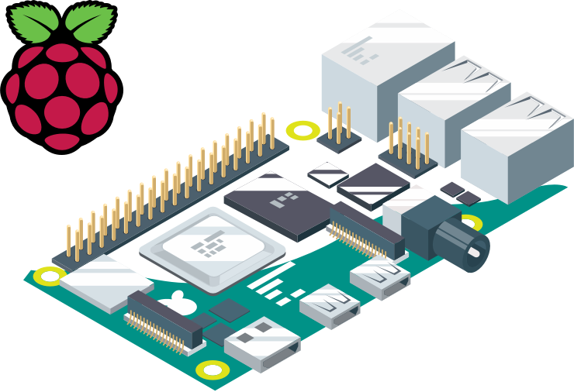




VisionXplorer
TECHNOLOGIES USED BEHIND THIS
Raspberry PI
Python: Programming Language
OpenCV: Library for doing Computer Vision
Application Programming Interface: Simply a “key-value” pair
Machine learning models
Text to Speech

Slide 7
VisionXplorer
What is raspberry pi?
Credit card-sized computer(controller) for small projects.
A microcontroller just like Arduino.
Energy efficient machine: Works on low powers.
General Purpose Input/Output pins provide easy connections with other hardware.
Cost Efficient technology

Slide 8

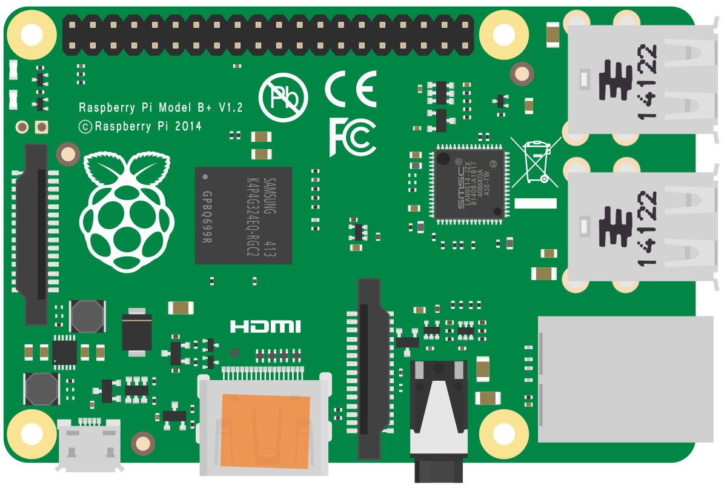


VisionXplorer
Working PRINCIPLE:
Live text translation
Live calculation
Data sent to Raspberry PI
Raspberry processes the information
Text translation API
Image input through camera module
Translated text being read aloud
Data sent to Raspberry PI
Raspberry processes the information
Image input through camera module
Output on display

Slide 9

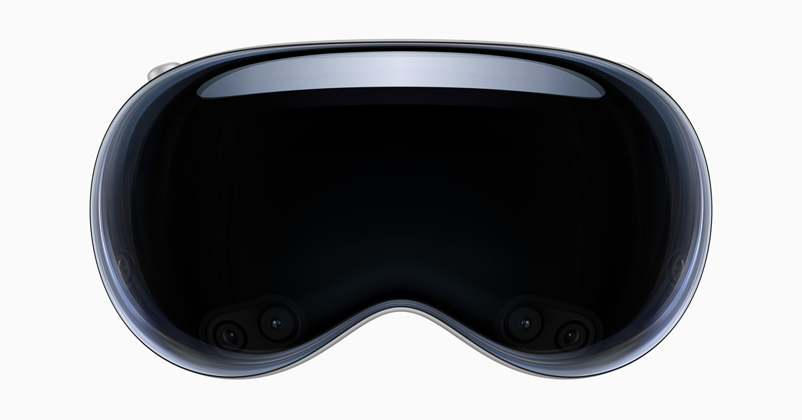
VisionXplorer
PRICE COMPARISON
APPLE VISION PRO | VisionXplorer
$3499 ≈ Rs. 2.9 Lakh
Rs. 6200

Slide 10
VisionXplorer
COST BREAKDOWN
Transparent OLED display | Rs. 1600
Frame | Rs. 100
Raspberry PI | Rs. 2900
Camera Module | Rs. 400
In/out audio module | Rs. 700
GPS module | Rs. 500
Rs. 6200

Slide 11
Future plans of VisionXplorer team
(Initial stage)
BETA
RELEASE
DEVELOPMENT CONTINUES…
Process those suggestions
Reach masses & make this a product of everyday use
Benefit the life of people
Suggestions

Slide 12

The VisionXplorer team
GitHub/
GitHub/PritishDash
GitHub/
GitHub/Soumyajit01
Garvith Murthal
The Technical head;
Pritish Dash
Junior programming lead;
Funder;
Labeeb
Technical Researcher
Soumyajit Dass
Project Supervisor
Programming lead

Slide 13
THANKS!

